Slide 1
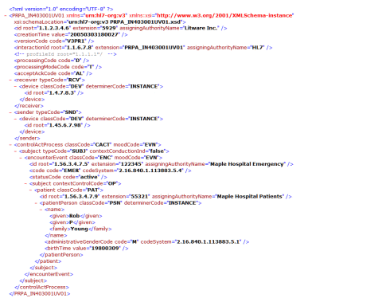
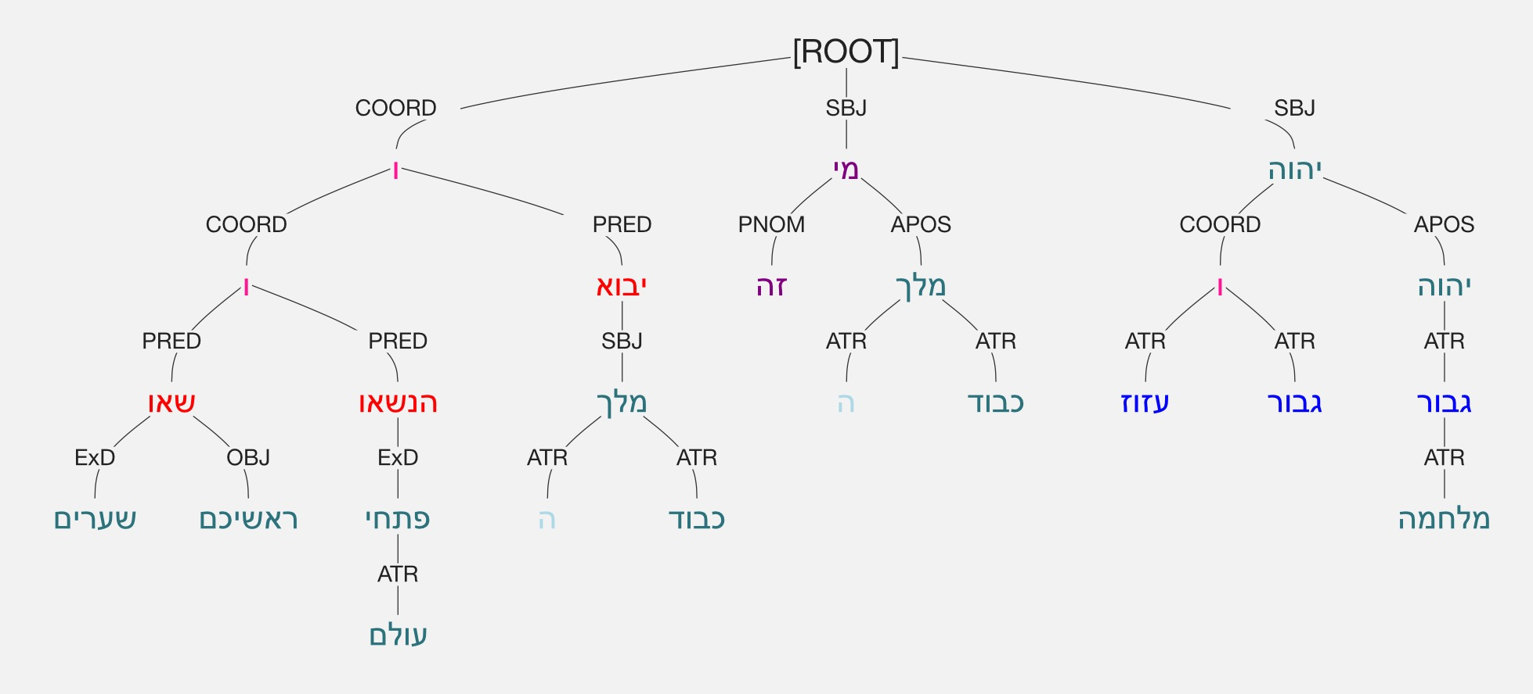

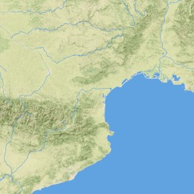
Digital Tools for the arts & humanities DIG 6837
Text-based tools
Instructor: Eleni Bozia
University of Florida

Slide 2
An interactive Timeline of racism & Immigration
By Nicole Reyes
file:///Users/lena/Downloads/digital_humanities_final%20(1)/final.html
file:///Users/lena/Downloads/digital_humanities_final%20(1)/odyssey.html
https://storymap.knightlab.com/
http://timeline.knightlab.com/

Slide 3
Thank you!

Slide 4
The Authorship of the Pauline Epistles
By Mary Elizabeth Johnson

Slide 5
Historical Background
A large portion of the New Testament consists of the Pauline letters, which are nominally attributed to the apostle Paul
Most scholars today believe it is extremely unlikely that Paul actually wrote all of the Pauline letters; it is more likely that his followers wrote some of them and attributed them to him following the practice of pseudepigraphy
Pseudepigraphic works were not uncommon in the ancient world and were written as if they had been written by a famous historical character; the real author typically remained anonymous
Scholars debate which of the Pauline letters were actually written by Paul himself and which are pseudepigraphic (meaning they were written by one of his followers using “Paul” as a pseudonym

Slide 6
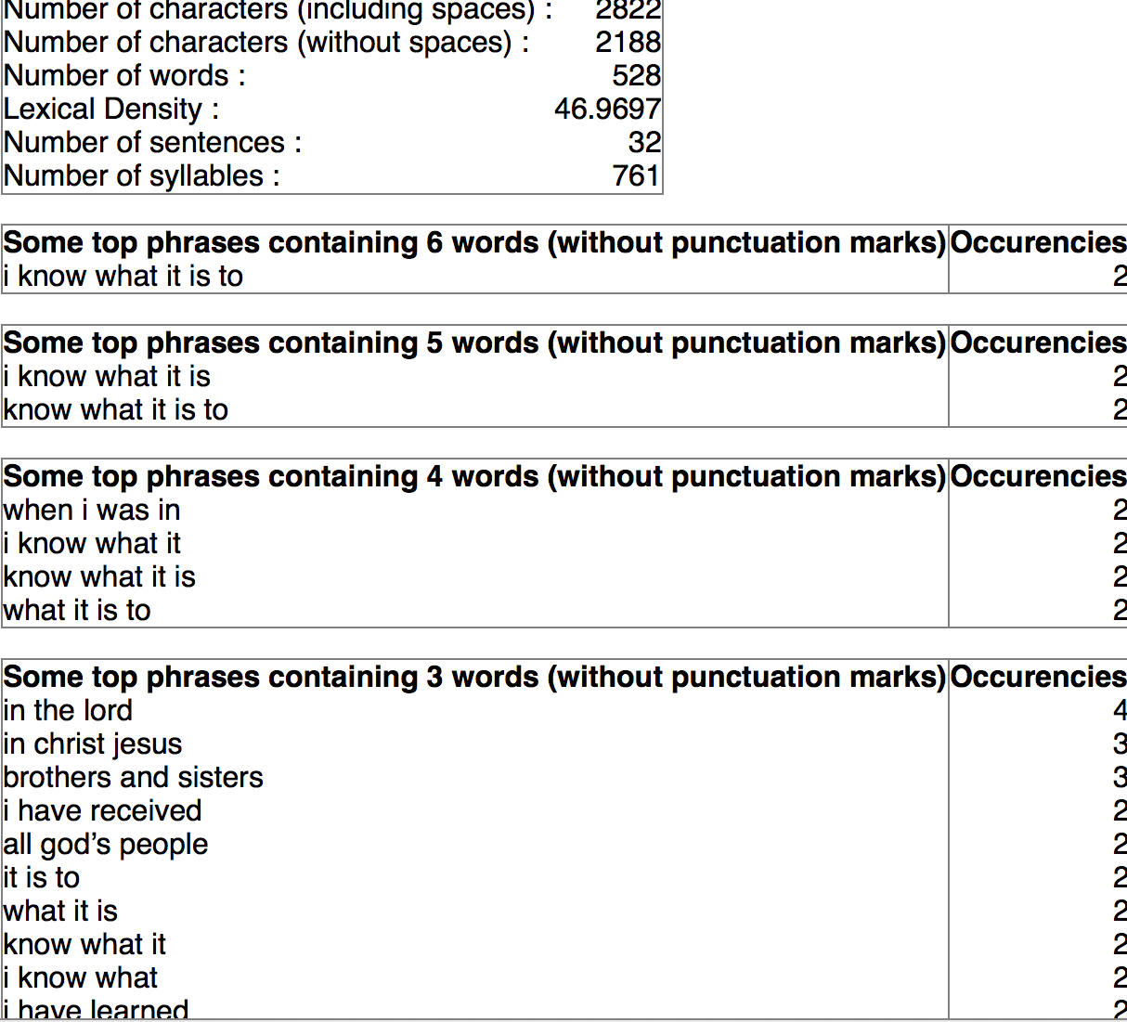
Text analysis tools
Online-Utility Text Analyzer
Shows strings of common words and common phrases
Tapor Text Analyzer
Shows frequencies of most common words
Shows at what areas of the text the most frequent words appear

Slide 7
The Disputed Pauline Letters
The unDisputed Pauline Letters
2 Thessalonians
Colossians
Ephesians
1 Timothy
2 Timothy
Titus
1 Thessalonians
1 Corinthians
2 Corinthians
Philippians
Philemon
Galatians
Romans

Slide 8
The Undisputed Letters
1 Corinthians and 2 Corinthians are both undisputed by most scholars and are believed to have been written around the same time (ca. 50’s A.D.). Four out of five of their top words are the same.
Others of the Undisputed Letters, including those believed to be written at later time periods such as 1 Thessalonians and Romans, also show similarities
1 Corinthians
2Corinthians
Philemon
1 Thessalonians
Romans

Slide 9
1 Thessalonians vs. 2 Thessalonians
Paul definitely wrote 1 Thessalonians (c. 50-51 A.D.)
If he also wrote 2 Thessalonians, it was probably soon after 1 Thessalonians
Results show only superficial similarities between the most common words and phrases in both texts
1 Thessalonians
2 Thessalonians

Slide 10
Colossians vs. Romans
If Paul wrote Colossians, he probably wrote it towards the end of his life
Romans is the latest letter definitively written by Paul (ca. 57-58 A.D.)
“Christ” and “god” are both high on the list in both letters as expected, but “faith” also appears highly on both (ranking sixth in both lists of single words and appearing in multiple highly ranked phrases as well)
Colossians
Romans

Slide 11
Colossians vs. Ephesians
Ephesians and Colossians are both disputed, but Colossians is considered more likely to have been written by Paul than Ephesians
Ephesians was likely written after Colossians
In both letters “christ” is the most common word, “god” the second most common, and “lord” is in the top five; however this could be considered coincidental
“Body” and “love” both appear in the top most common words of both documents and are not commonly found in many of the other epistles
Colossians
Ephesians

Slide 12
The Pastoral Epistles
“Good” is the second most common word in both 1 Timothy and Titus
“People” is one of the top five most common words in both 1 Timothy and Tiitus
“Faith” is one of the top most five common words in both 1 and 2 Timothy
“Love” is one of the most common words in all three letters
1 Timothy, 2 Timothy, and Titus
Most likely written by followers of Paul later in the first century
Scholars debate whether or not they were written by the same author if they were not written by Paul
Expected words such as “god,” “Christ,” “lord,” and “Jesus” appear often in all three texts
1 Timothy
2 Timothy
Titus

Slide 13
Sources
http://catholic-resources.org/Bible/Paul-Disputed.htm

Slide 14
Thank you!

Slide 15
Coffee Website
By Liliana Lovo

Slide 16
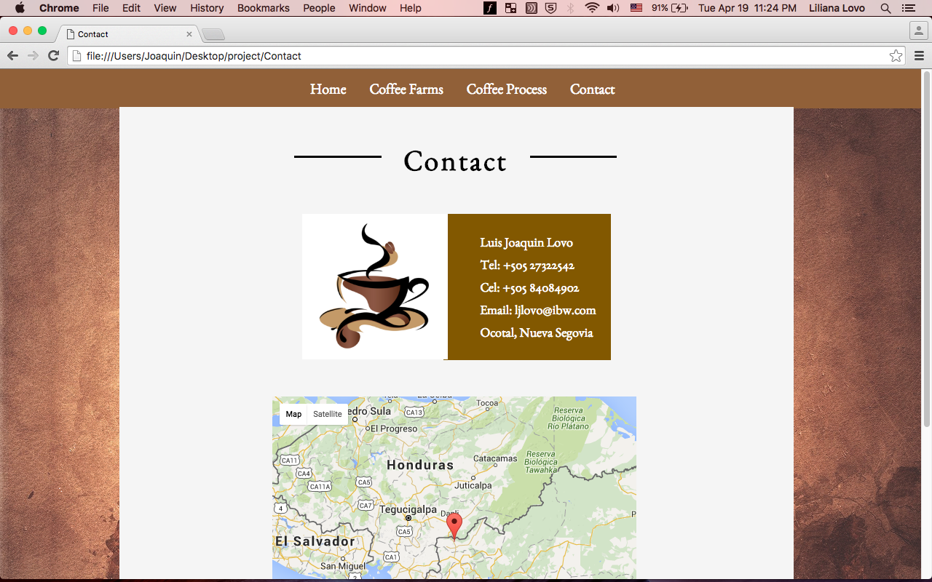
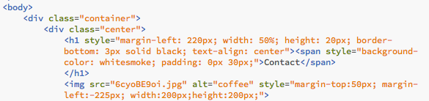
HTML

Slide 17
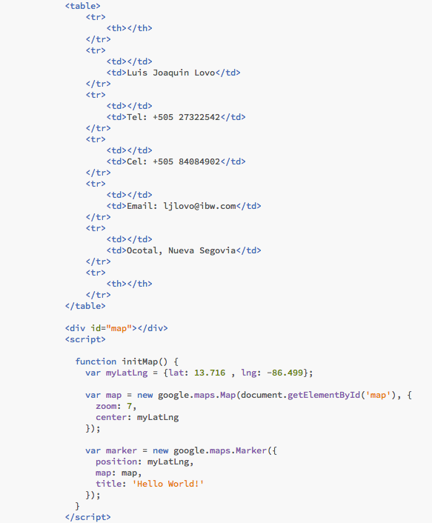

Slide 18
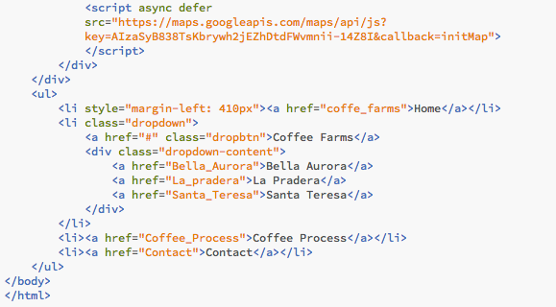

Slide 19
Data
My dad provided me with the information and photos from the actual farms
The description of the farms were written by my dad

Slide 20
Website Design
It consists of 6 pages
It has a menu and 1 drop down menu
Super simple design

Slide 21
file:///Users/lena/Desktop/Liliana_FinalProject/index.html

Slide 22
Thank you!

Slide 35
Thank you!

Slide 36
En(Twine)d with Ergodic Rhetoric
Caleb Milligan
20 April 2016

Slide 37
Hypertextuality
Hypertext fiction has been a prominent genre of electronic literature since Michael Joyce’s Afternoon, a story published in 1990.
Twine continues this tradition through an accessible open-source platform for telling interactive non-linear stories.
I want to propose using Twine to author non-linear academic arguments.

Slide 38
Twinery
Twine is a hypertext story editor created by Chris Klimas in 2009.
It has since become incredibly popular with indie game developers for its freedom of expression and use.
As it requires no coding experience, I want to suggest Twine as an excellent beginner’s program for digital humanities composition.

Slide 39
Academy
Interactive, non-linear storytelling as an academic pursuit is already proliferating.
From 80 Days to Interactive Salem Witch Trials, entertainment to education, choose-your-own-adventure could be reconsidered choose-your-own-aesthetic-argument.
http://www.inklestudios.com/80days/
http://digitalhumanities.wlu.edu/blog/2016/04/11/michelle-brock-on-choose-your-own-witch-trials/

Slide 40
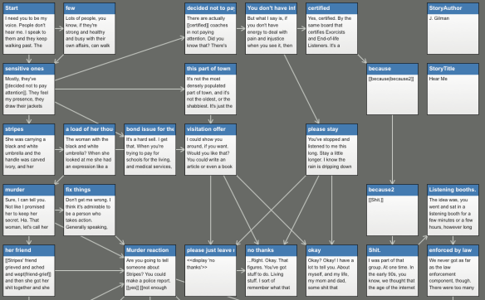
Intricacy
To create links, all one has to [[bracket]] words like so.
Through minimal code-like language, one can change the color of their project, add images, embed videos, and more.
Utilizing the visual metaphor of the blueprint, Twine stories appear as networked maps while you write them.

Slide 41
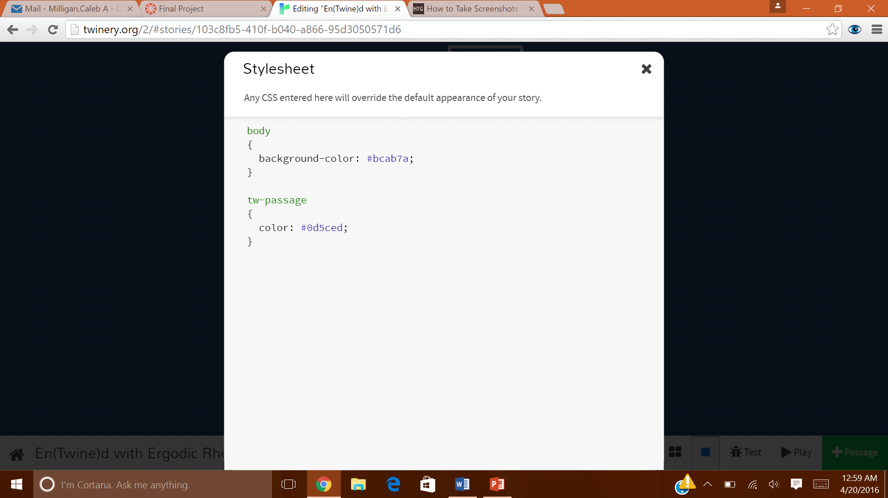
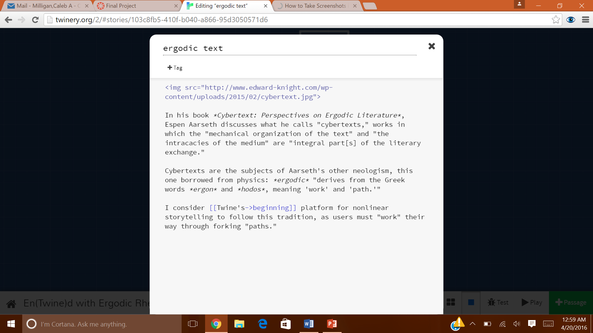
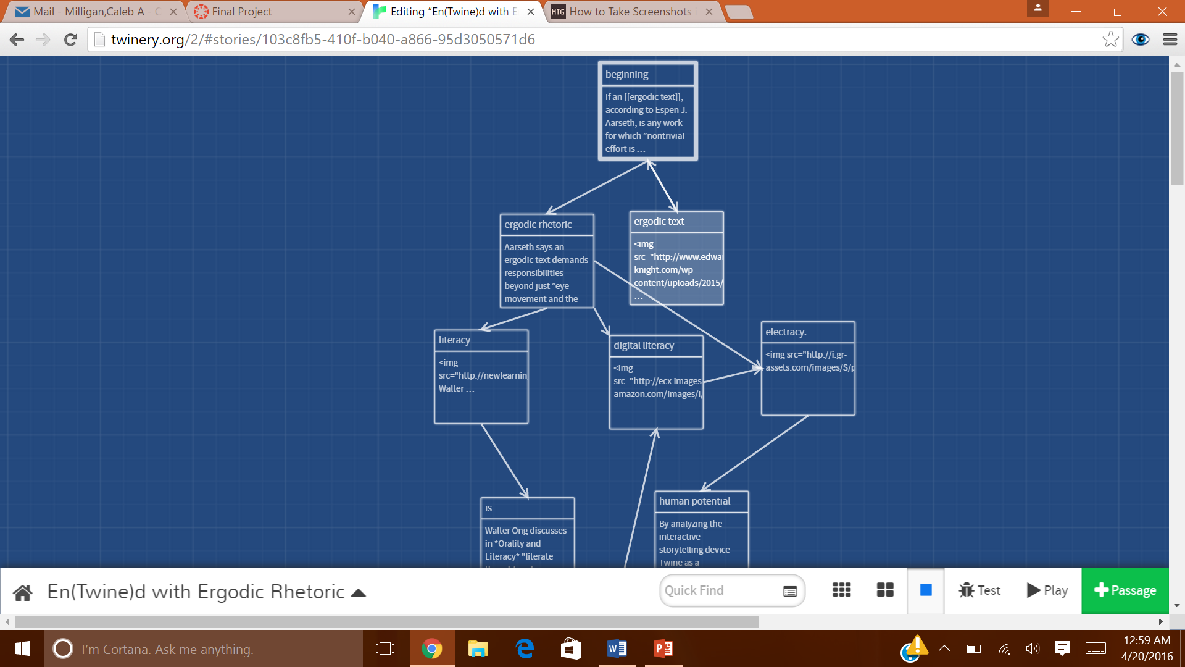
Specificity
Below are some screenshots of what the Twine interface looks like:

Slide 42
Mastery
The included link directs to my Twine project, “En(Twine)d with Ergodic Rhetoric”:
http://philome.la/Camilliganaire/entwined-with-ergodic-rhetoric
Thank you very much!

Slide 43
Thank you!

Slide 44
DIG6931C – DIGITAL TOOLS FOR ARTS & HUMANITIES
SILK ROAD – YESTERDAY & TODAY
(An interactive presentation of the role of Silk Road in shaping modern world )
by
You Mo (Digital Arts & Sciences)
Sandeep Bedadala (Digital Arts & Sciences)
Shan Yan (Digital Arts & Sciences)
Alberto De Simoni (Classics)

Slide 45
Why?
The Idea
Initial considerations
Approach
Link to project

Slide 46
What?
Tools discussed in classroom
Tools used in this project
Challenges
Wordcloud Generator
Google Maps API

Slide 47
How?
How the tools are used
Open Source tools
Collecting Data
Source

Slide 48
Final Product
Navigation
Wordcloud
How to use this project

Slide 49
Thank you!

Slide 50
The Logical Flow of Psalm 24
Adapted from:
"Who is this King of Glory?" The Early Church's Christological Interpretation of Psalm 24:
A Historical-Grammatical and Canonical Analysis with an Evaluation

Slide 51
Introduction
Parallelism: linchpin of biblical poetry
Intensification through Parallelism:
Geographical Focusing
Topical Specification
Temporal Progression
Spacial Advancement
Follow both the structural & the thematic movement
Interpret within canonical context

Slide 52
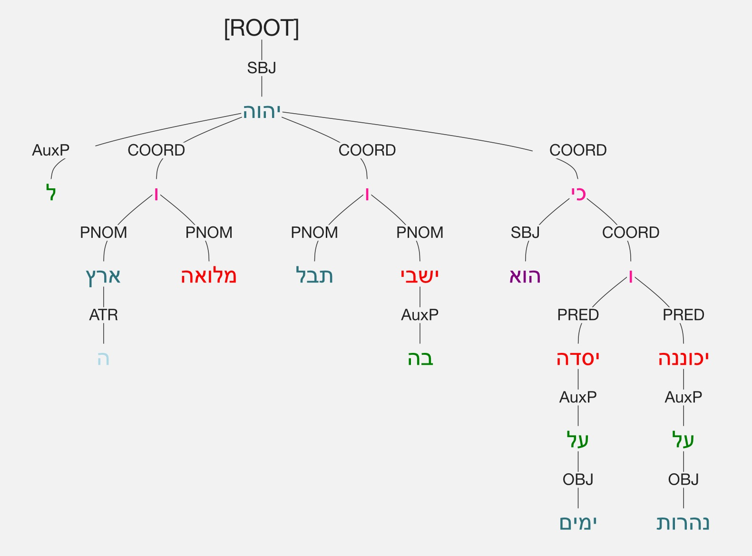
Verses 1-2:
Earth/land; that which fills/those who dwell; seas/rivers
From larger to smaller
Creation of world/creation of Eden
Similar to focusing in Genesis 1-2
Same language
Yahweh's is the earth and that which fills it,
The land and those who dwell in it;
For upon the seas He founded it,
And upon the rivers He established it.
Yahweh made the world
Yahweh owns its inhabitants
Yahweh can judge its inhabitants
Psalms 96:10-13; 98:7-9

Slide 53
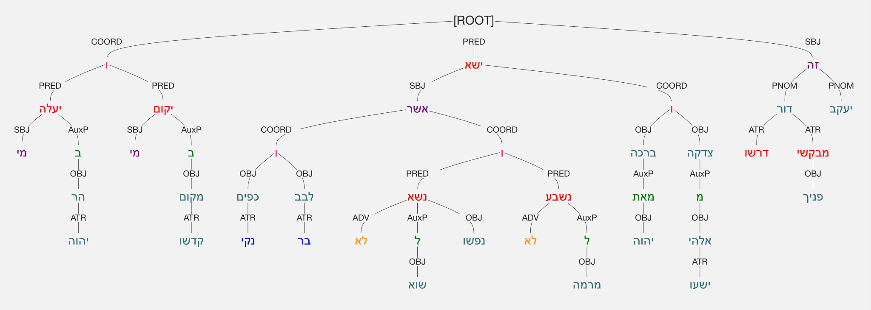
Verses 3-6:
Who will ascend the mount of Yahweh,
And who will stand up in His holy place?
The one with clean hands,
And the man with a pure heart,
He who does not lift up his soul to vanity,
And who does not make a false pledge:
He will obtain blessing from Yahweh,
And righteousness from the God of his salvation.
This is the generation of those who seek Him,
Those who seek Your face,
Namely, Jacob.
Eden, Sinai, tabernacle, & temple
Terminology, structure, & function
Inward motion & specification
who will ascend or stand?/he will receive/this is the generation
Moral qualifications
Inward/outward; God/neighbor; actively obeys/avoids disobeying
Shift from group to individual entering
Those who seek him/you; Jacob; the King of glory
Potential for to actualization of judgement
Sinful man not permitted to enter
Man can't fulfill requirements
Man doesn't meet requirements
Yet people enter & receive blessing

Slide 54
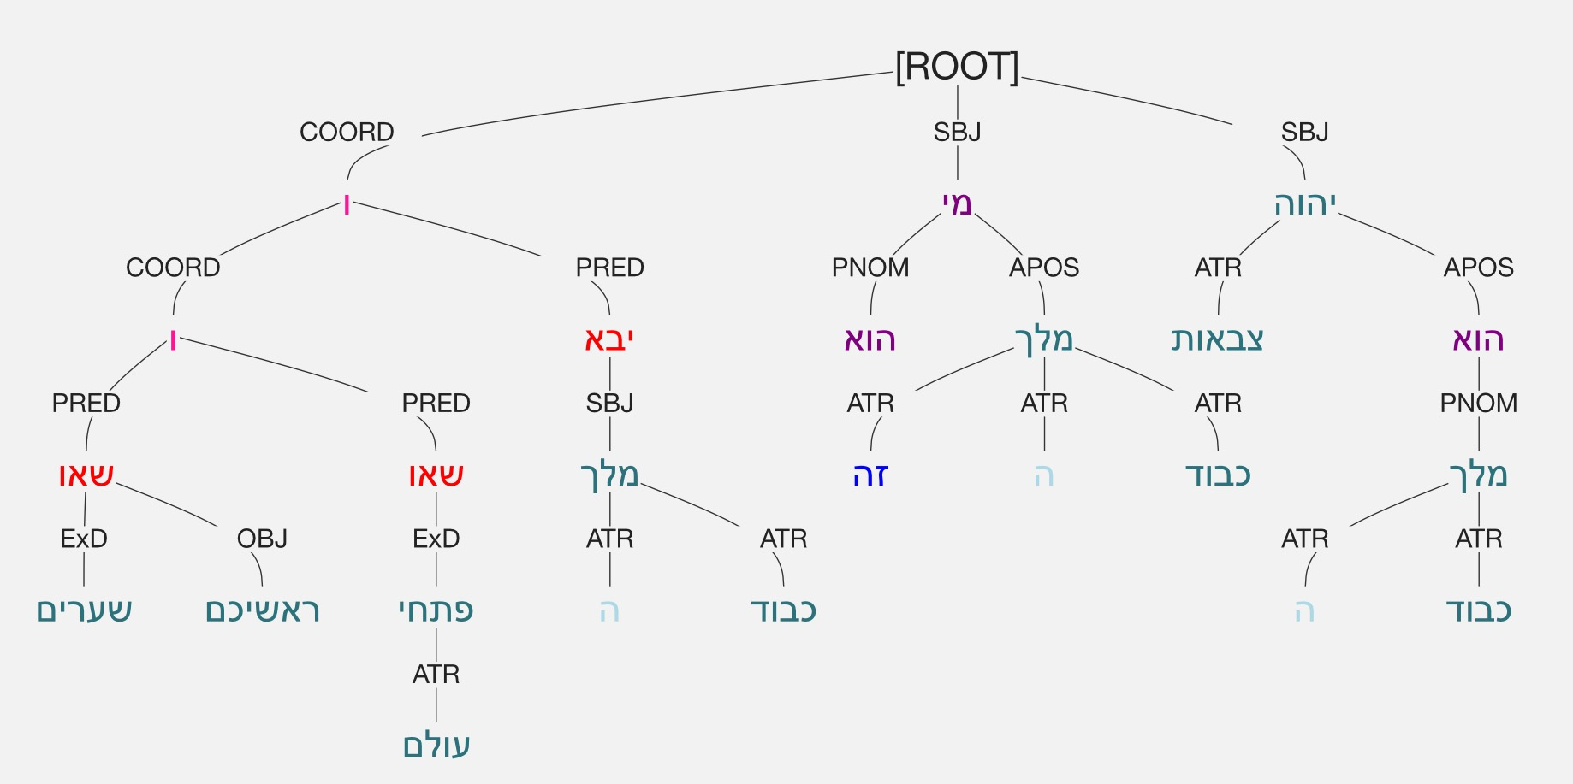
Verses 7-10
Raise, O gates, your heads!
And be raised up, eternal doors!
And the King of glory will enter!
Who is this? The King of glory?
Yahweh strong and heroic!
Yahweh heroic in war!
Raise, O gates, your heads!
And arise, eternal doors!
And the King of glory will enter!
Who is He, this King of glory?
Yahweh of armies!
He is the King of glory!
Individual in place of group
Manifold roles of individual
Yahweh as a man
Yahweh entering the presence of Yahweh
Precedent Scene
Suffering Servant
Subsequent Scene
Enthroned Lord
Why do the gentiles rage,
And the peoples grumble in vain...
Against Yahweh and against His Messiah?..
Then He will speak to them in His anger,
And terrify them in His wrath:
"I have consecrated my King on Zion, my holy mount."
I will relate the decree, Yahweh said to me:
"You are my Son, today I have begotten you."

Slide 55
Thank you!

